Slide 1
Lesson 3 – Object-oriented programming

Slide 2
Lesson goals
Basics
Principles
OOP in Java

Slide 3
OOP Basics

Slide 4
What is OOP
One of the paradigms (techniques) to write programs
Everything is an “Object”
Object is a “Class” instance
Object has a state and behavior
Program – is a set of interacting objects

Slide 5
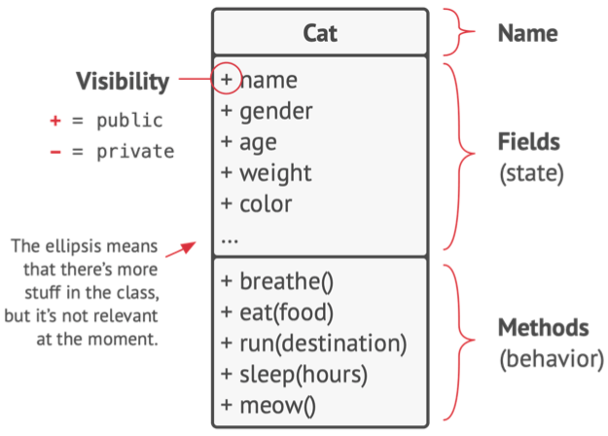
Class structure

Slide 6
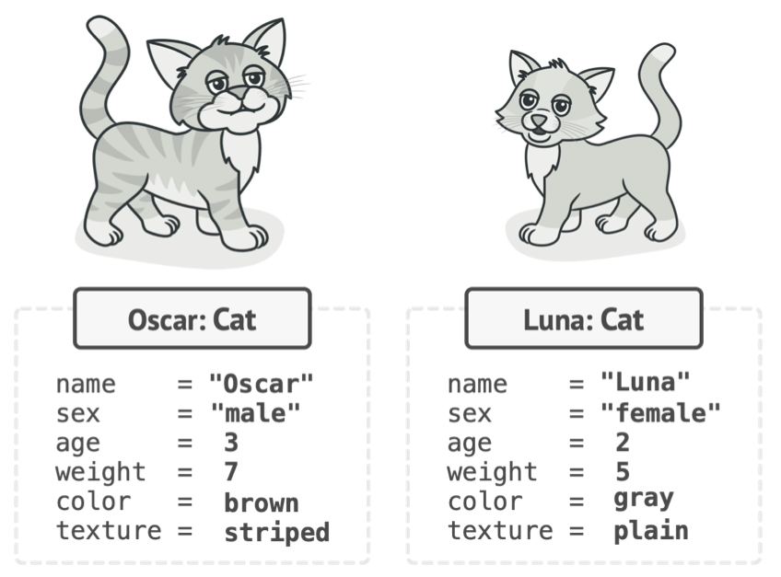
Object

Slide 7
Class vs Object
class Cat { String name; String gender; int age; float weight; Color color; Texture texture; void breathe() { … } void eat(String food) { … } void run(String destination) { … } void sleep(int hours) { … }
void meow() { System.out.println("Meow!"); } }
public static void main(String[] args) { Cat oscar = new Cat(); Cat luna = new Cat(); luna.sleep(2); oscar.meow(); }

Slide 8
Method vs Constructor
Method describes behavior
Method signature:
name
arguments (including order)
Specific method with the same to class name and without return statement called Constructor
To invoke constructor use “new” keyword

Slide 9
Constructor example
class Cat { String name; public Cat() { } }
or
class Cat { String name; Cat() { this("Oscar"); } Cat(String name) { this.name = name; } }
public static void main(String[] args) { Cat cat = new Cat(); Cat catWithName = new Cat("Oscar"); println("cat = " + cat); println("catWithName = " + catWithName); }

Slide 10
Overloading priority
Exact match by type
Matching a superclass type
Converting to a larger primitive type
Converting to an autoboxed type
Varargs

Slide 11
Overloading example
class Overloading { static void overloadedMethod(int i) { //will enter if nothing is commented System.out.println("in int"); } static void overloadedMethod(long i) { //will enter if comment 'int' System.out.println("in long"); } static void overloadedMethod(Integer i) { //will enter if comment 'int' and 'long' System.out.println("in Integer"); } static void overloadedMethod(Number i) { //will enter if comment 'int’, 'long' and 'Integer' System.out.println("in Number"); } static void overloadedMethod(int... i) { //will enter if comment 'int’, 'long’, 'Integer' and 'Number' System.out.println("in var arg"); } public static void main(String[] args) { overloadedMethod(10); } }

Slide 12
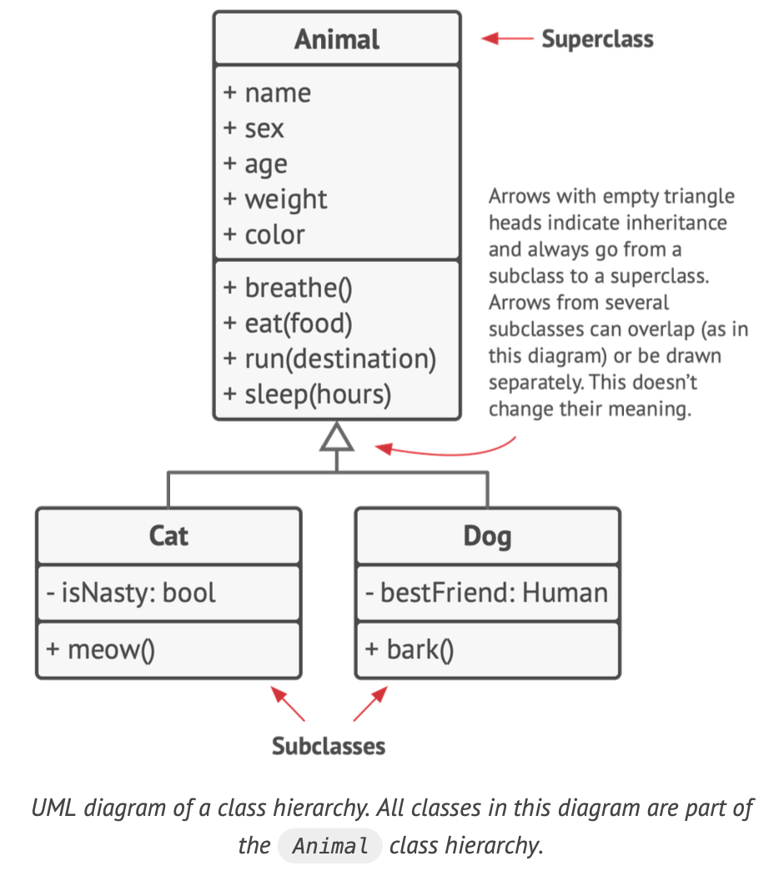
Class hierarchies

Slide 13
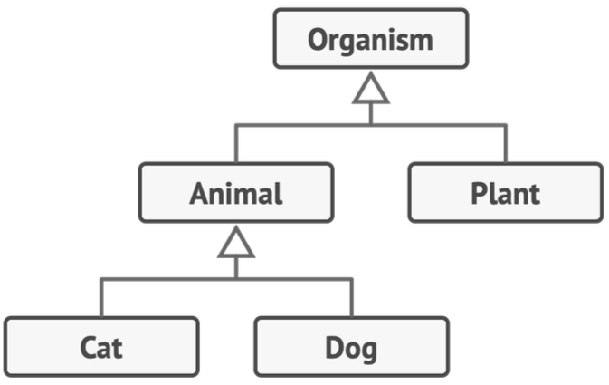
Complex hierarchy example

Slide 14
OOP Principles

Slide 15
Design principle
A design principle is an established idea or best practice that facilitates the software design process.
More logical code
Code that is easier to understand
Classes that are easier to reuse in other relationships and applications
Code that is easier to maintain

Slide 16
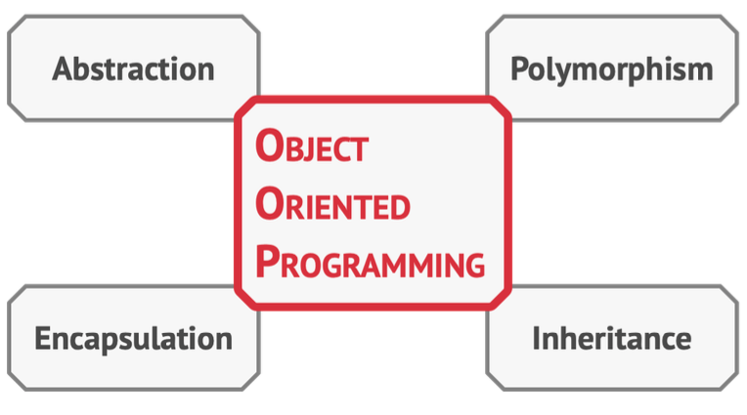
OOP Principles (aka Pillars of OOP)

Slide 17
Abstraction is a model of a real-world object or phenomenon, limited to a specific context, which represents all details relevant to this context with high accuracy and omits all the rest.

Slide 18
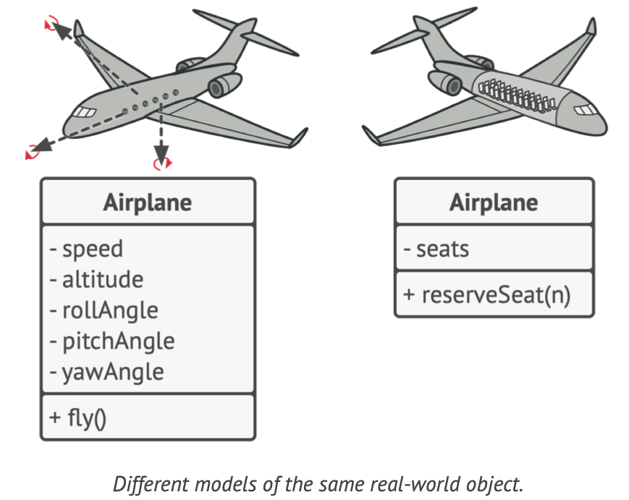
Abstraction example

Slide 19
Abstraction in Java
Interface
Abstract Class
Class

Slide 20
Interface example
interface Animal { void breathe(); void eat(String food); }

Slide 21
Interface usage
interface Animal { void breathe(); void eat(String food); }
class Cat implements Animal {
String name; @Override public void breathe() { println("breathing"); } @Override public void eat(String food) { println("eat food"); } }

Slide 22
Interface features
Defines a set of public abstract methods, which classes implementing the interface must provide.
Allows you to define what a class can do without saying how to do it (interface is a contract, for behavior of object)
A class may implement multiple interfaces as well as extend class that implements interfaces, allowing for limited multiple inheritance in Java
May extend other interfaces, although they may not extend a class and vice versa
May contain public static final constant values, public, private and static methods, public default methods.

Slide 23
Abstract class example
abstract class Animal { String name; void breathe() { System.out.println("breathes"); } abstract void eat(String food); }

Slide 24
Abstract class usage
abstract class Animal { String name; void breathe() { println("breathes"); } abstract void eat(String food); }
class Cat extends Animal { @Override public void eat(String food) { println("eat food"); } }

Slide 25
Abstract Class features
May contain any number of methods including zero
If class has at least one abstract method – class is abstract
Abstract methods may not appear in a class that is not abstract
The first concrete subclass of an abstract class is required to implement all abstract methods that were not implemented by a superclass

Slide 26
Abstract Class vs Interface
abstract class Animal { String name; void breathe() { println("breathes"); } abstract void eat(String food); }
interface Animal { default void breathe() { println("breathes"); } void eat(String food); }

Slide 27
Encapsulation is the ability of an object(or component) to hide parts of its state and behaviors from other objects, exposing only a limit- ed interface to the rest of the program.

Slide 28
Encapsulation types
Access modifiers
public
protected
package private
private
Public Contract (interfaces)

Slide 29
Encapsulation. Access modifiers
class Cat { public String name;
protected String gender;
int age;
private float weight; }
Can be used for classes, fields, methods

Slide 30
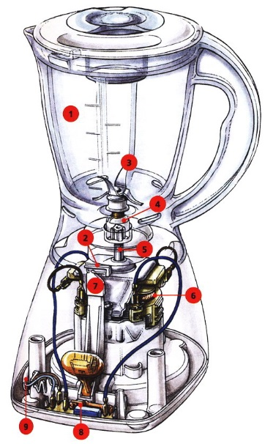

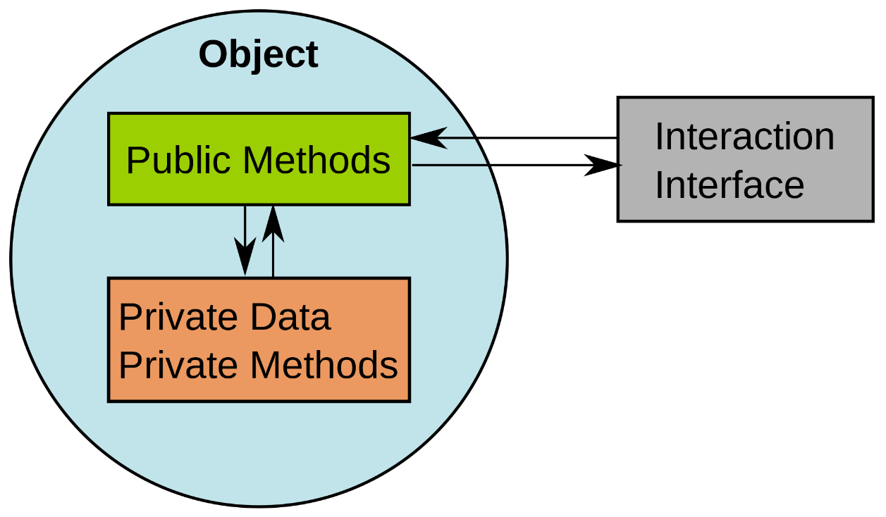
Encapsulation

Slide 31
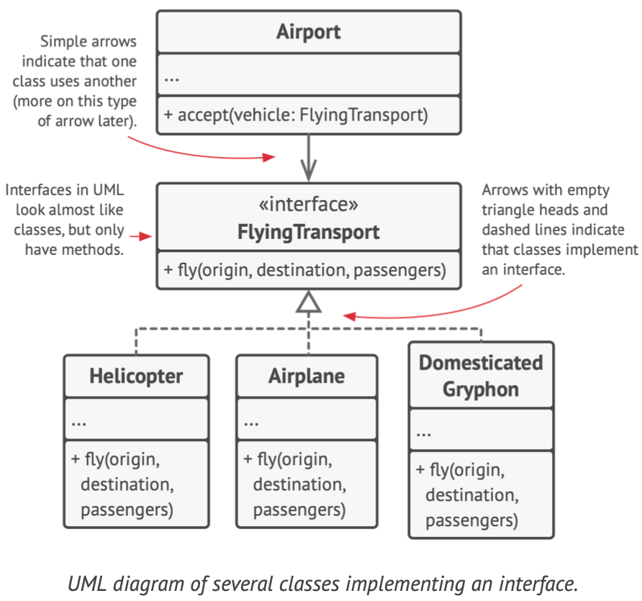
Encapsulation. Public Contract (interfaces)

Slide 32
Encapsulation. Example Java POJO
Plain Old Java Object
Fields
Constructors (partial construction problem)
Methods
Possible name suffix or synonyms: *Bean, *Dto, *Data

Slide 33
Encapsulation. Demo Java POJO

Slide 34
Encapsulation. Example Java POJO
public class Dog { private final String name; public Dog(String name) { this.name = name; } public String getName() { return name; } @Override public String toString() { return "Dog{" + "name='" + name + '\'' + '}'; } }

Slide 35
Inheritance is the ability to build new classes on top of existing ones. The main benefit of inheritance is code reuse.

Slide 36
Inheritance features
Reduces code duplications
Adds extra functionality (by extending already existing code in a subclass)
Subclasses have the same interface as their parent class
You can’t hide a method in a subclass if it was declared in the superclass
You must also implement all abstract methods, even if they don’t make sense for your subclass. (more in SOLID principles – Interface segregation)

Slide 37
Inheritance features
In most programming languages a subclass can extend only one superclass
On the other hand, any class can implement several interfaces at the same time
Inheritances expresses “is-a” relationship between two objects.
In Java operator “instanceof” is used to check ”is-a” relationship

Slide 38
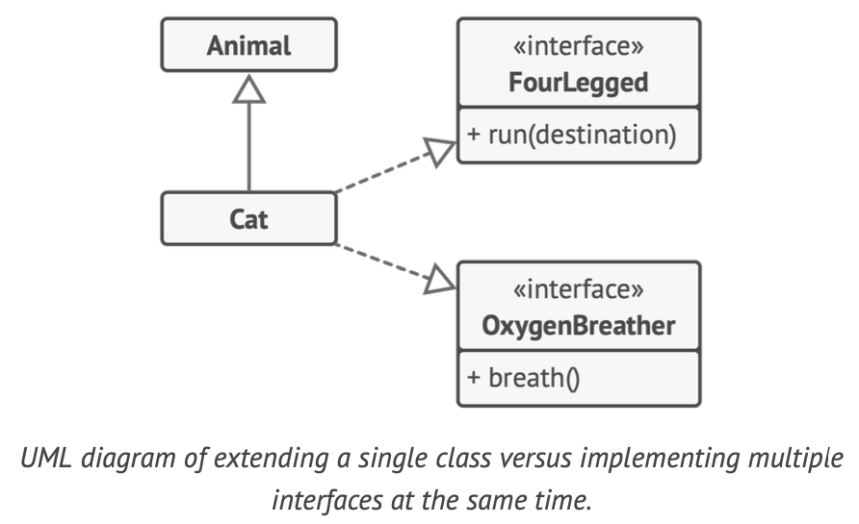
Inheritance example

Slide 39
Inheritance example
abstract class Animal { String name; void breathe() { System.out.println("breathes"); } abstract Number num(); }
public interface FourLegged { void run(String destination); }
public interface OxygenBreather { void breath(); }
class Cat extends Animal implements FourLegged, OxygenBreather { @Override public void run(String destination) { println("run to " + destination); } @Override public void breath() { println("breathes !!!"); } }

Slide 40
Overriding rules
The access modifier must be the same or more accessible;
The return type must be the same or a more restrictive type, also known as covariant return types;
@Override - It is a mandatory to using in order to avoid accidentally overloading a method.
If any checked exceptions are thrown, only the same exceptions or subclasses of those exceptions can be thrown;
The methods must not be static. (If they are, the method is hidden and not overridden);

Slide 41
Overloading vs Overriding
class Game { void play() { // move to the left } } class SuperMarioBros extends Game {
@Override public void play() { // move to the left, move to the right } void play(Character character) { // do something } }

Slide 42
Interfaces inheritance
public interface OxygenBreather { void breath(); }
public interface FourLegged extends OxygenBreather { void run(String destination); }
class Cat implements FourLegged, OxygenBreather { @Override public void run(String destination) { println("run to " + destination); } @Override public void breath() { println("breathes !!!"); } }

Slide 43
Polymorphism is the ability of a program to detect the real class of an object and call its implementation even when its real type is unknown in the current context.

Slide 44
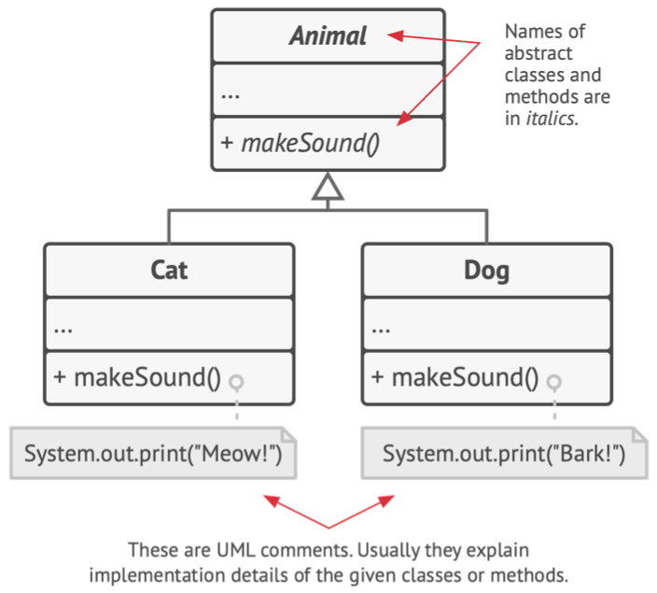
Polymorphism example

Slide 45
Polymorphism example
abstract class Animal { abstract void makeSound(); }
class Cat extends Animal { @Override void makeSound() { println("Meow!"); } }
public class Dog extends Animal { @Override void makeSound() { println("Bark!"); } }
public static void main(String[] args) { Animal cat = new Cat(); Animal dog = new Dog(); cat.makeSound(); // Meow! dog.makeSound(); // Bark! }

Slide 46
Polymorphism features
An object in Java may take on a variety of forms, in part depending on the reference used to access the object.
One name, many forms. Polymorphism manifests itself by having multiple methods all with the same name, but slightly different functionality.
There are 2 basic types of polymorphism.
Overriding, also called run-time (dynamic) polymorphism.
Overloading, which is referred to as compile-time (static) polymorphism.

Slide 47
OOP principles. Polymorphism
The type of the object determines which properties exist within the object in memory.
The type of the reference to the object determines which methods and variables are accessible to the Java program
Polymorphism is the ability of a single interface to support multiple underlying forms.

Slide 48
Huh, that’s all about some concepts of OOP 😅
But we have to learn more in the future:
- Relations Between Objects
- SOLID Principles
- Design Patterns
And more …

Slide 49
Enumeration
A special data type that enables for a variable to be a set of predefined constants
Has unique set of values
Can implement interface
Can NOT extend class
Can contain fields and methods
Singleton (🧐 *design pattern)

Slide 50
Enumeration example
java.time.Month ->
public enum Month implements TemporalAccessor, TemporalAdjuster { JANUARY, FEBRUARY, MARCH, APRIL, MAY, JUNE, JULY, AUGUST, SEPTEMBER, OCTOBER, NOVEMBER, DECEMBER; // ... custom methods, or implementations }

Slide 51
Homework
Read about Academic Grading system on Wikipedia
Lets add objects to our Students Registry console application. User should input 3 values:
Name
Number of grade [0 .. 100]
Grade type
Store this data into a Student object

Slide 52
Homework
Read about Academic Grading system on Wikipedia
Lets add objects to our Students Registry console application. The idea is to ask user for input student data(name, grade number and grade type) and group students by Grade type and display them in a table views.
User should input 3 values (input values are corect):
Name
Grade number [0 .. 100]
Grade type (enumeration)
Store Name and Grade data into a Student object:
Use an interface Grade for field that will store grade

Slide 53
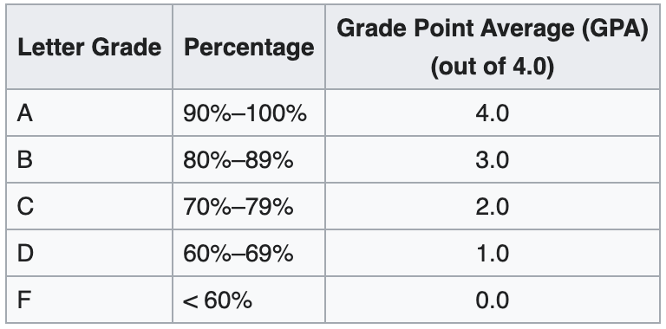
Homework
Interface Grade should have 3 implementations according to table:

Slide 54
Homework
Grade objects should be created by GradeFactory interface implementation
IMPORTANT: It's restricted to change any contract interfaces
Group Students by their Grade types
Sort students by Grades, then by Names
Print Students in a Table representation

Slide 55
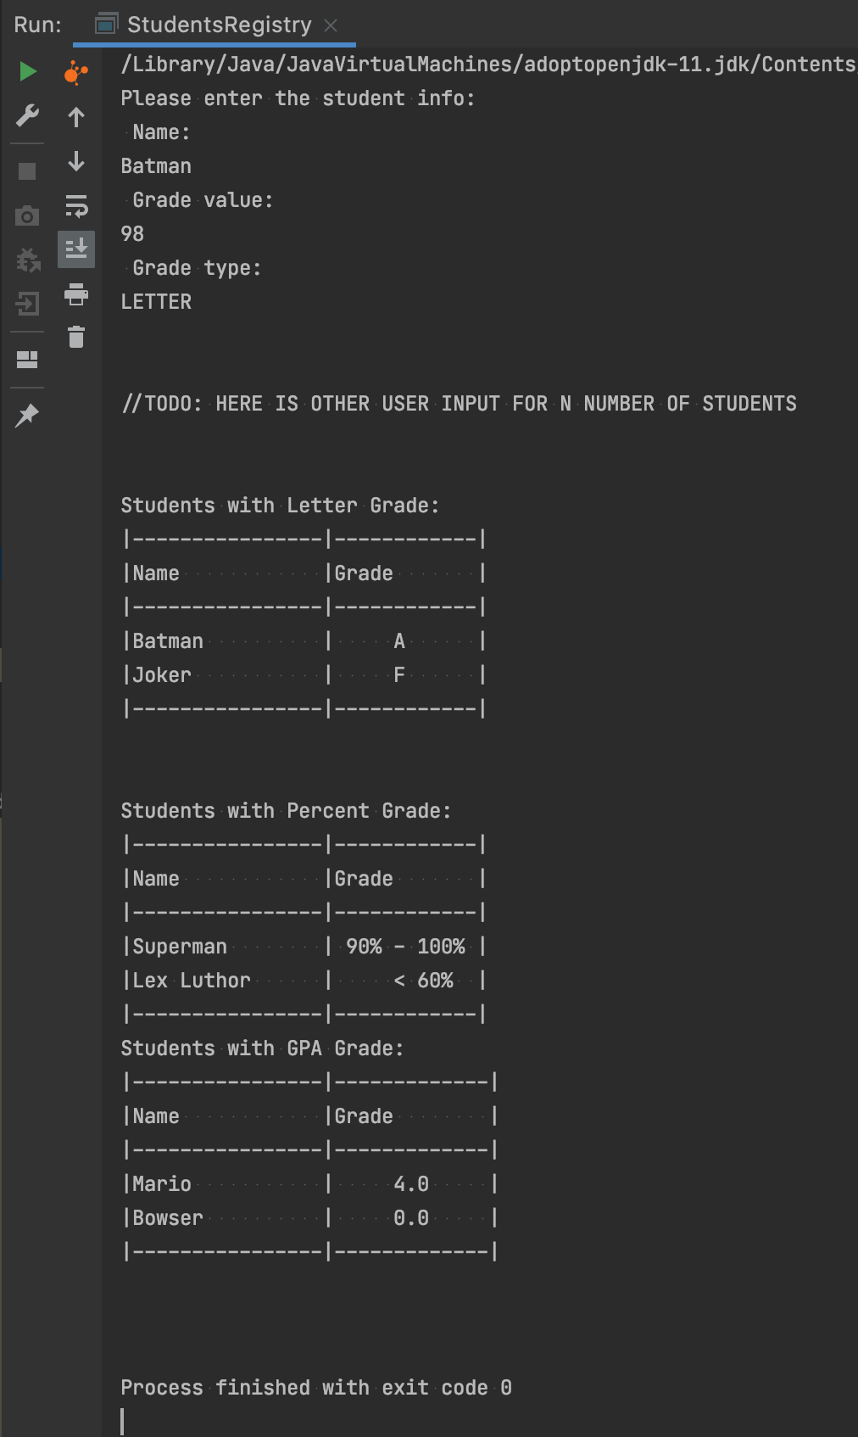
Homework: UI/UX Example

Slide 56
Homework: HackerRank
https://www.hackerrank.com/challenges/java-inheritance-1/problem
https://www.hackerrank.com/challenges/java-inheritance-2/problem
https://www.hackerrank.com/challenges/java-abstract-class/problem
https://www.hackerrank.com/challenges/java-interface/problem
https://www.hackerrank.com/challenges/java-method-overriding/problem
https://www.hackerrank.com/challenges/java-instanceof-keyword/problem

Slide 57
Links
Object-Oriented-Programming Concepts in Java
Java Classes and Objects

Slide 58
Thanks!
Any Questions?
Or find us in Slack:
@Yaroslav Brahinets
@Vasya Rudas

